Slide 1
Design for Testability Theory and Practice
Lecture 5: Testability Measures
Definition
Controllability and observability
SCOAP measures
  Combinational circuits
  Sequential circuits
Summary

Slide 2
What are Testability Measures?
Approximate measures of:
  Difficulty of setting internal circuit lines to 0 or 1 from primary inputs.
  Difficulty of observing internal circuit lines at primary outputs.
Applications:
  Analysis of difficulty of testing internal circuit parts – redesign or add special test hardware.
  Guidance for algorithms computing test patterns – avoid using hard-to-control lines.

Slide 3
Testability Analysis
Determines testability measures
Involves Circuit Topological analysis, but no
test vectors (static analysis) and no search algorithm.
Linear computational complexity
  Otherwise, is pointless – might as well use
  automatic test-pattern generation and
  calculate:
    Exact fault coverage
    Exact test vectors

Slide 4
SCOAP Measures
SCOAP – Sandia Controllability and Observability Analysis Program
Combinational measures:
  CC0 – Difficulty of setting circuit line to logic 0
  CC1 – Difficulty of setting circuit line to logic 1
  CO – Difficulty of observing a circuit line
Sequential measures – analogous:
  SC0
  SC1
  SO
Ref.: L. H. Goldstein, “Controllability/Observability Analysis of Digital Circuits,” IEEE Trans. CAS, vol. CAS-26, no. 9. pp. 685 – 693, Sep. 1979.

Slide 5
Range of SCOAP Measures
Controllabilities – 1 (easiest) to infinity (hardest)
Observabilities – 0 (easiest) to infinity (hardest)
Combinational measures:
  Roughly proportional to number of circuit lines that must be set to control or observe given line.
Sequential measures:
  Roughly proportional to number of times flip-flops must be clocked to control or observe given line.

Slide 6
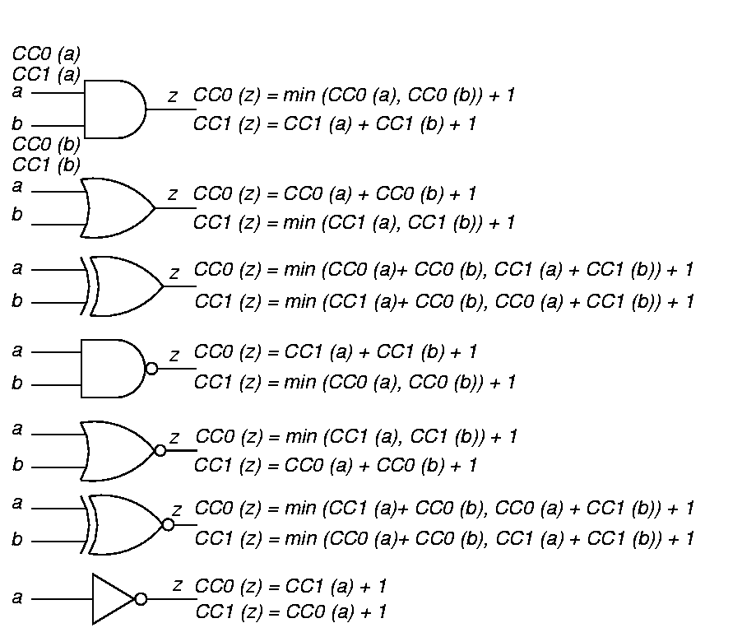
Combinational Controllability

Slide 7
Controllability Formulas
(Continued)

Slide 8
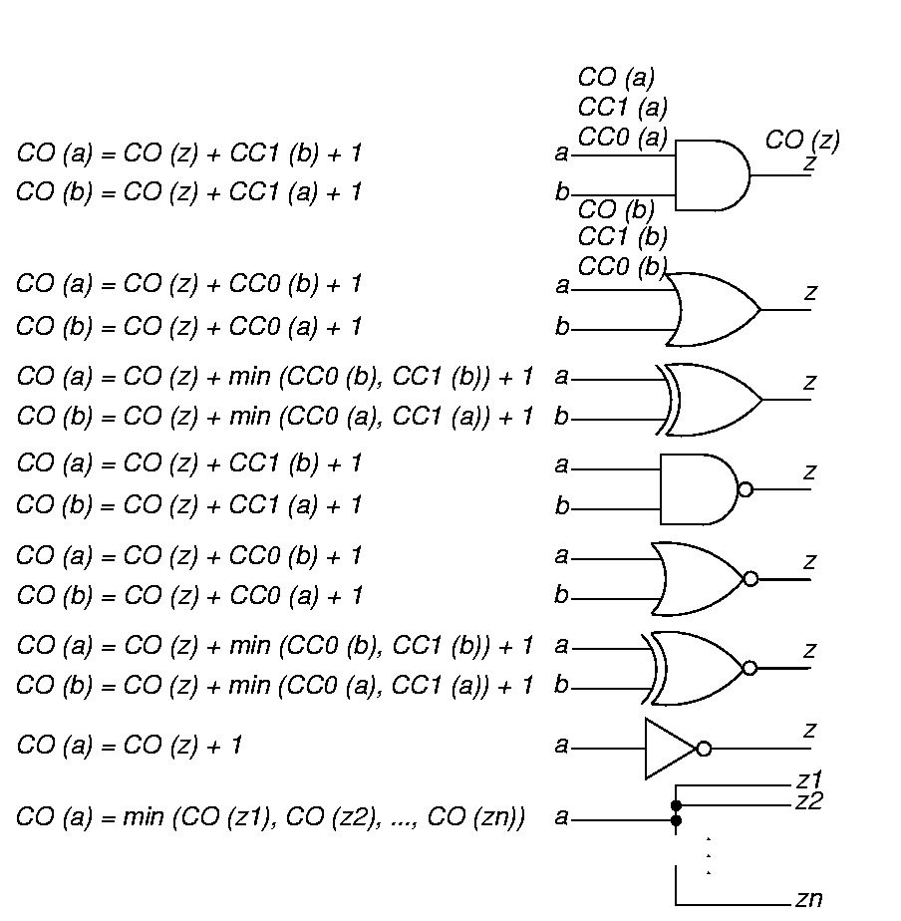
Combinational Observability
To observe a gate input: Observe output and make other input values non-controlling.

Slide 9
Observability Formulas
(Continued)
Fanout stem: Observe through branch with best observability.

Slide 10
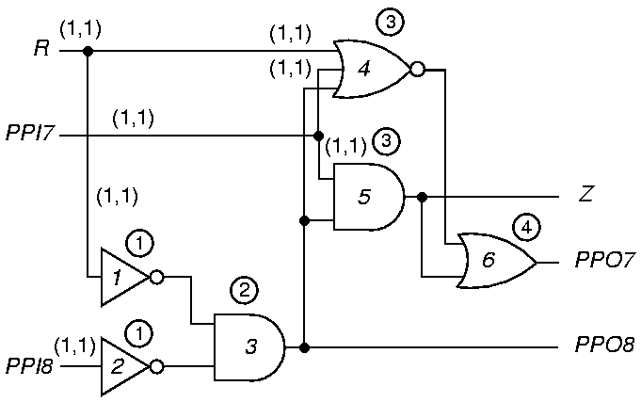
Comb. Controllability
Circled numbers give level number. (CC0, CC1)

Slide 11
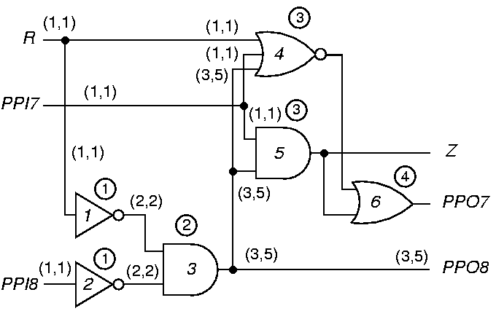
Controllability Through Level 2

Slide 12
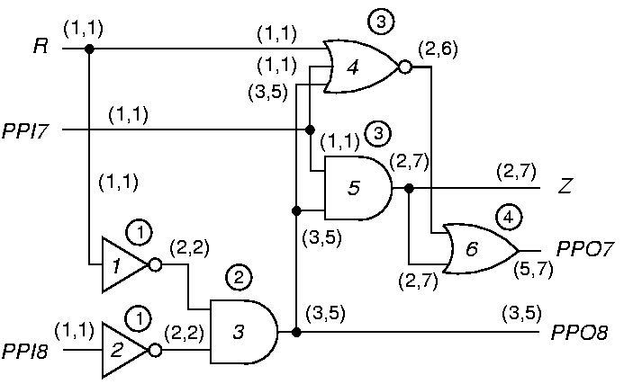
Final Combinational Controllability

Slide 13
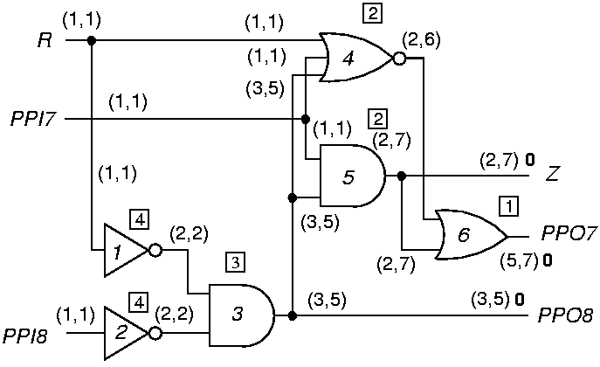
Combinational Observability for Level 1
Number in square box is level from primary outputs (POs).
(CC0, CC1) CO

Slide 14
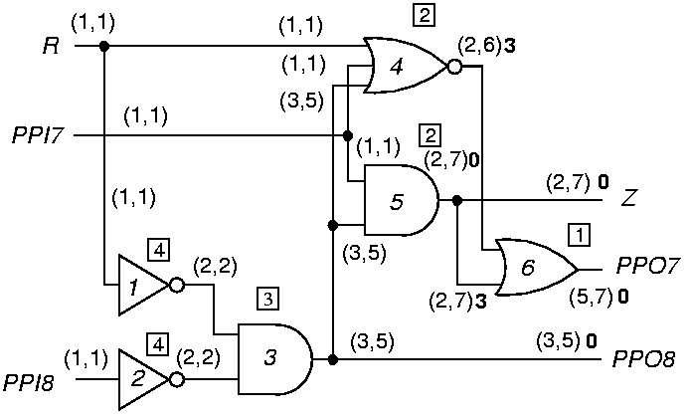
Combinational Observabilities for Level 2

Slide 15
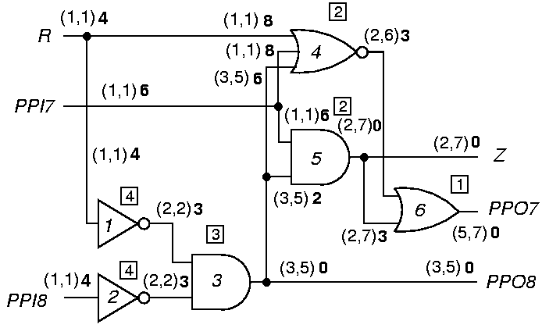
Final Combinational Observabilities

Slide 16
Sequential Measures (Comparison)
Combinational
  Increment CC0, CC1, CO whenever you pass through a gate, either forward or backward.
Sequential
  Increment SC0, SC1, SO only when you pass through a flip-flop, either forward or backward.
Both
  Must iterate on feedback loops until controllabilities stabilize.

Slide 17
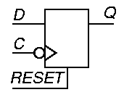
D Flip-Flop Equations
Assume a synchronous RESET line.
CC1 (Q) = CC1 (D) + CC1 (C) + CC0 (C) + CC0
(RESET)
SC1 (Q) = SC1 (D) + SC1 (C) + SC0 (C) + SC0
(RESET) + 1
CC0 (Q) = min [CC1 (RESET) + CC1 (C) + CC0 (C),
CC0 (D) + CC1 (C) + CC0 (C)]
SC0 (Q) is analogous
CO (D) = CO (Q) + CC1 (C) + CC0 (C) + CC0
(RESET)
SO (D) is analogous

Slide 18
D Flip-Flop Clock and Reset
CO (RESET) = CO (Q) + CC1 (Q) + CC1 (RESET) +
CC1 (C) + CC0 (C)
SO (RESET) is analogous
Three ways to observe the clock line:
  Set Q to 1 and clock in a 0 from D
  Set the flip-flop and then reset it
  Reset the flip-flop and clock in a 1 from D
CO (C) = min [ CO (Q) + CC1 (Q) + CC0 (D) +
CC1 (C) + CC0 (C),
CO (Q) + CC1 (Q) + CC1 (RESET) +
CC1 (C) + CC0 (C),
CO (Q) + CC0 (Q) + CC0 (RESET) +
CC1 (D) + CC1 (C) + CC0 (C)]
SO (C) is analogous

Slide 19
Testability Computation
For all PIs, CC0 = CC1 = 1 and SC0 = SC1 = 0
For all other nodes, CC0 = CC1 = SC0 = SC1 = ∞
Go from PIs to POs, using CC and SC equations to get controllabilities -- Iterate on loops until SC stabilizes -- convergence is guaranteed.
Set CO = SO = 0 for POs, ∞ for all other lines.
Work from POs to PIs, Use CO, SO, and controllabilities to get observabilities.
Fanout stem (CO, SO) = min branch (CO, SO)
If a CC or SC (CO or SO) is ∞ , that node is uncontrollable (unobservable).

Slide 20
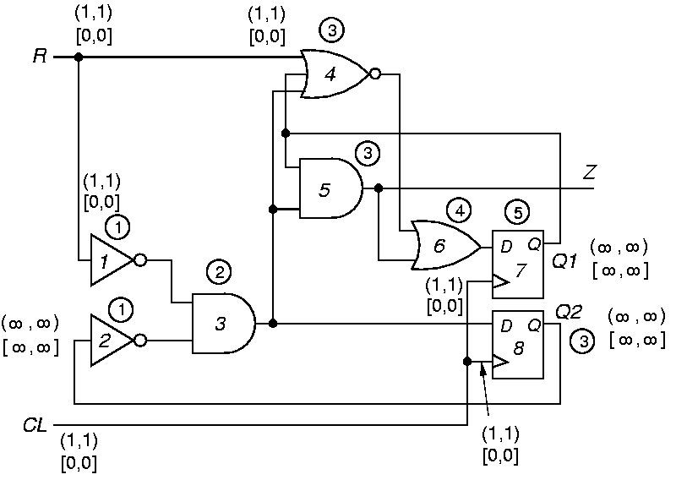
Sequential Example Initialization

Slide 21
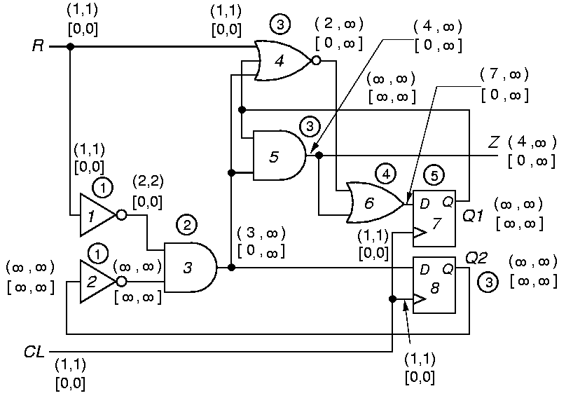
After 1 Iteration

Slide 22
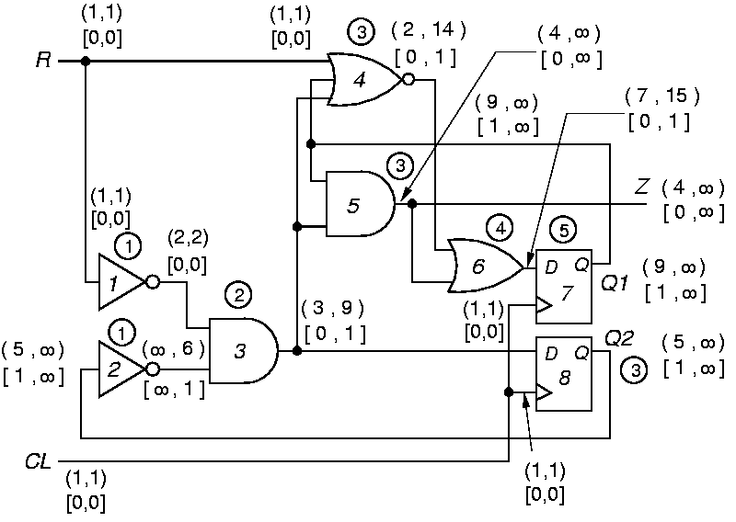
After 2 Iterations

Slide 23
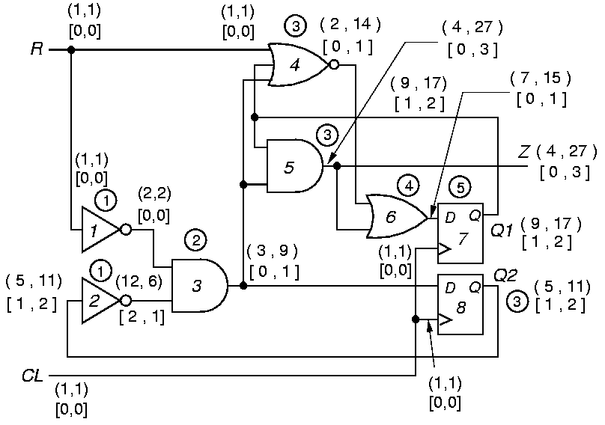
After 3 Iterations

Slide 24

Stable Sequential Measures

Slide 25
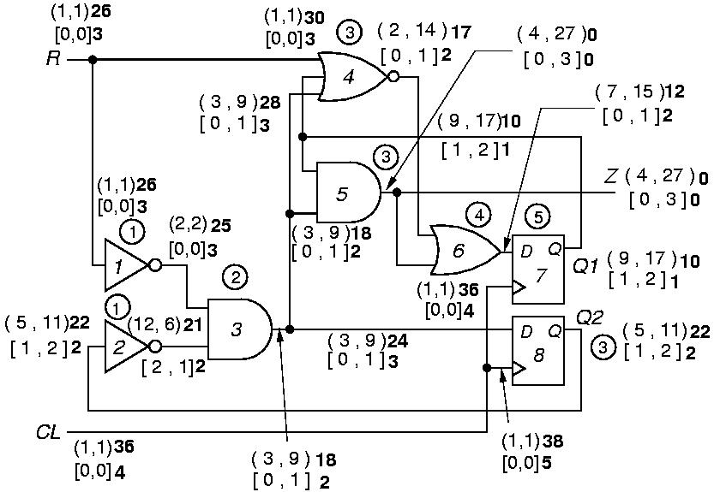
Final Sequential Observabilities

Slide 26
Summary
Testability measures are approximate measures of:
  Difficulty of setting circuit lines to 0 or 1
  Difficulty of observing internal circuit lines
Applications:
  Analysis of difficulty of testing internal circuit parts
    Redesign circuit hardware or add special test hardware where measures show poor controllability or observability.
  Guidance for algorithms computing test patterns – avoid using hard-to-control lines

